Slide 1


CapStone Project
By Lulua Shahmalak

Slide 2
For my capstone project, I had the privilege of working with the United States Food and Drug Administration (FDA) to gather and analyze publications produced under their office. The objective was to assess the productivity across the FDA's various divisions and programs.

Slide 3

Let me introduce you to our FDA world
U.S. Food and Drug Administration
Center for Devices and Radiological Health
Office of Science and Engineering Laboratories
Front Office
Jenna Osborn (Scientific Project Manager)
Lope Talacay (Quality and Project Manager)
Matt Klink (ORISE Fellow)
Nicole Leung (ORISE Fellow)

Slide 4

What is OSEL
The Front Office is a crucial part of OSEL providing strategic guidance and support for regulatory research.
OSEL has four technological divisions covering around twenty different fields of research program topics.
Applied Mechanics Division (DAM)
Biomedical Physics Division (DBP)
Division of Materials Science, Chemistry, and Biology (DBCMS)
Division of Software Reliability, Imaging, and Diagnostics (DIDSR)
Notes:
Continuing on with this project, I will be using these acronyms instead of these whole names.

Slide 5

DATA MINING EFFORT
Collect Input keywords
- OSEL
- DAM
- BBP
- DBCMS
- DIDSR
Search for each Input on PubMed
-web scraping program to collect submission numbers and metadata in a spreadsheet for the Front Office
Analyze data from search results

Slide 6
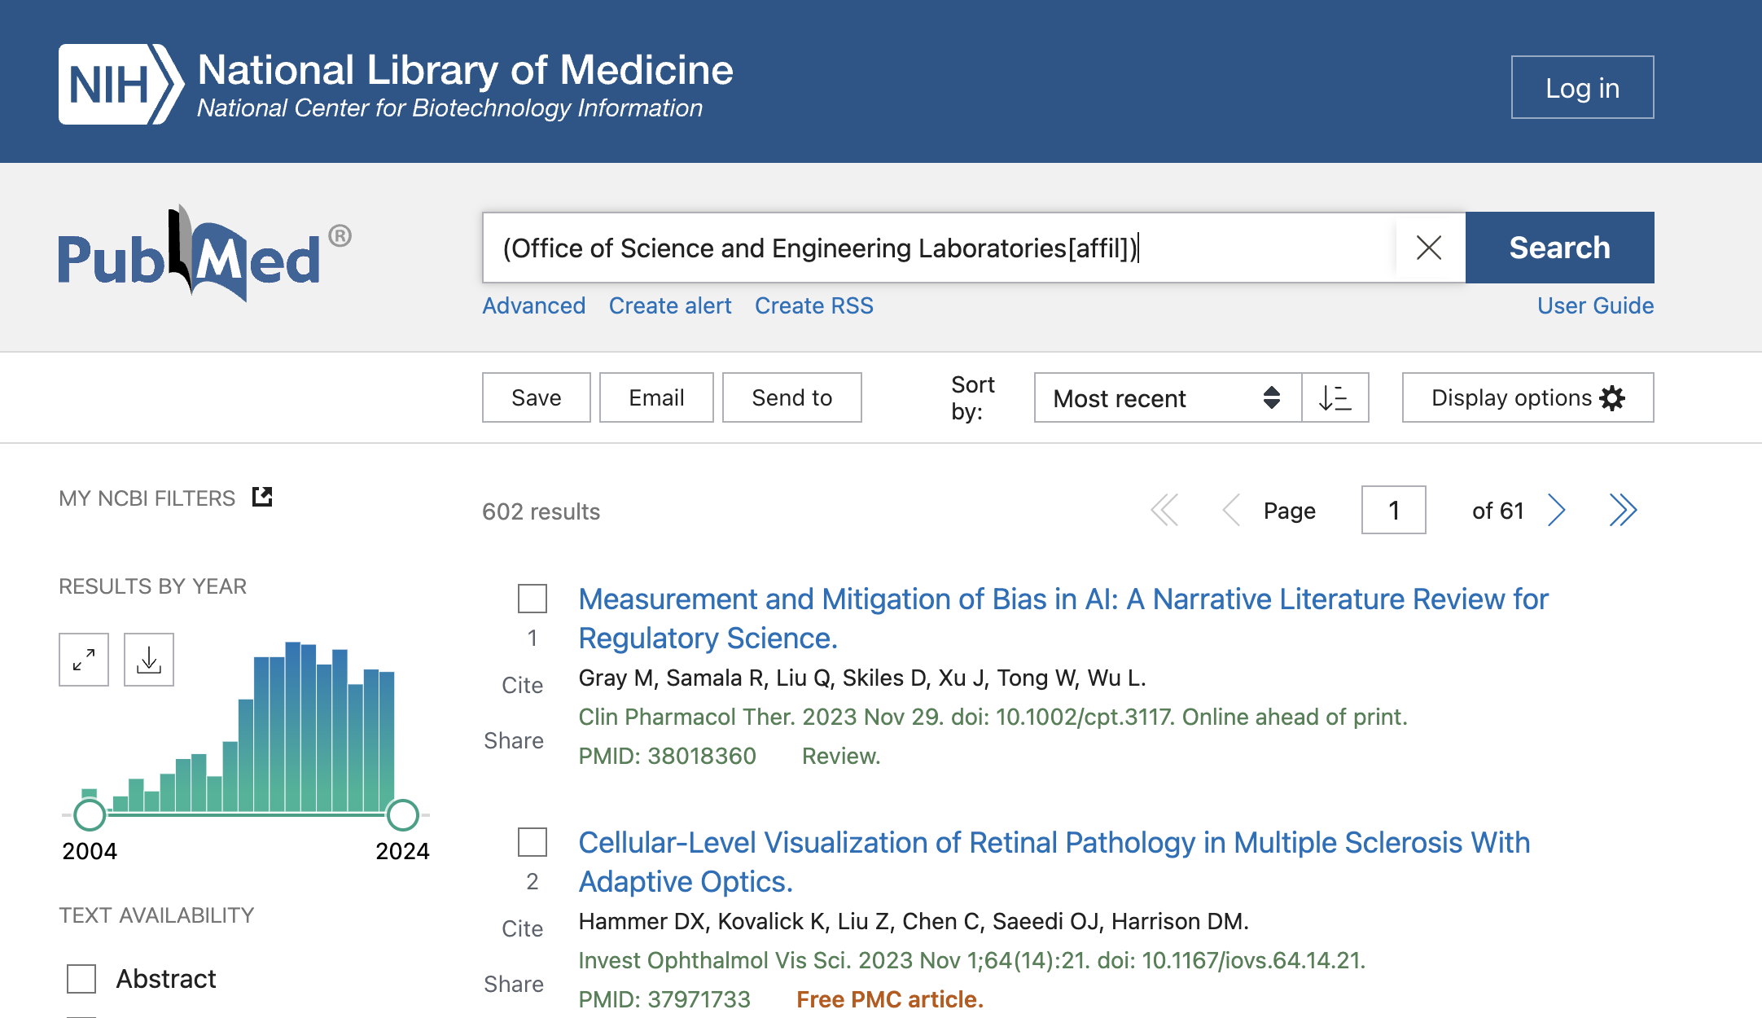
What is Web scraping?
Web scraping is when you use a computer program to automatically extract information from websites
I used the PubMed data base to scrape any publications off the internet listed under the affiliation of OSEL
The results were stored in a dataset

Slide 7
Goals of this Project
Promote OSEL work within the center, and strengthen ties with other groups by measuring the productivity of regulatory research performed under OSEL
Assess collaboration by analyzing the number of authors per publication.
Assess productivity – which program is more productive
Identify the authors and evaluate their impacts on divisions and programs within OSEL.

Slide 8
My Data Set
Quality of data: The data has about 1000 observations with a total of 15 variables
Tools used – beautifulsoup library for web scraping and Python programming
Data provided it to me by the FDA
Data scraped under:
OSEL
DAM
DBP
DIDSR
DBCMS

Slide 9
Data Wrangling and Cleaning
Merging each dataset together
Cleaning data – no duplicates, any row without a division was invalid
Fill in information about the inputs that is missing – publication year
Create a new quantitative variable of number of authors per publication
Filter divisions to finalize 4 divisions of OSEL
Filter program names so all programs are under the known 20 programs of OSEL
Split Author names so that each author can be analyzed separately

Slide 10

Exploratory Data Analysis

Slide 11
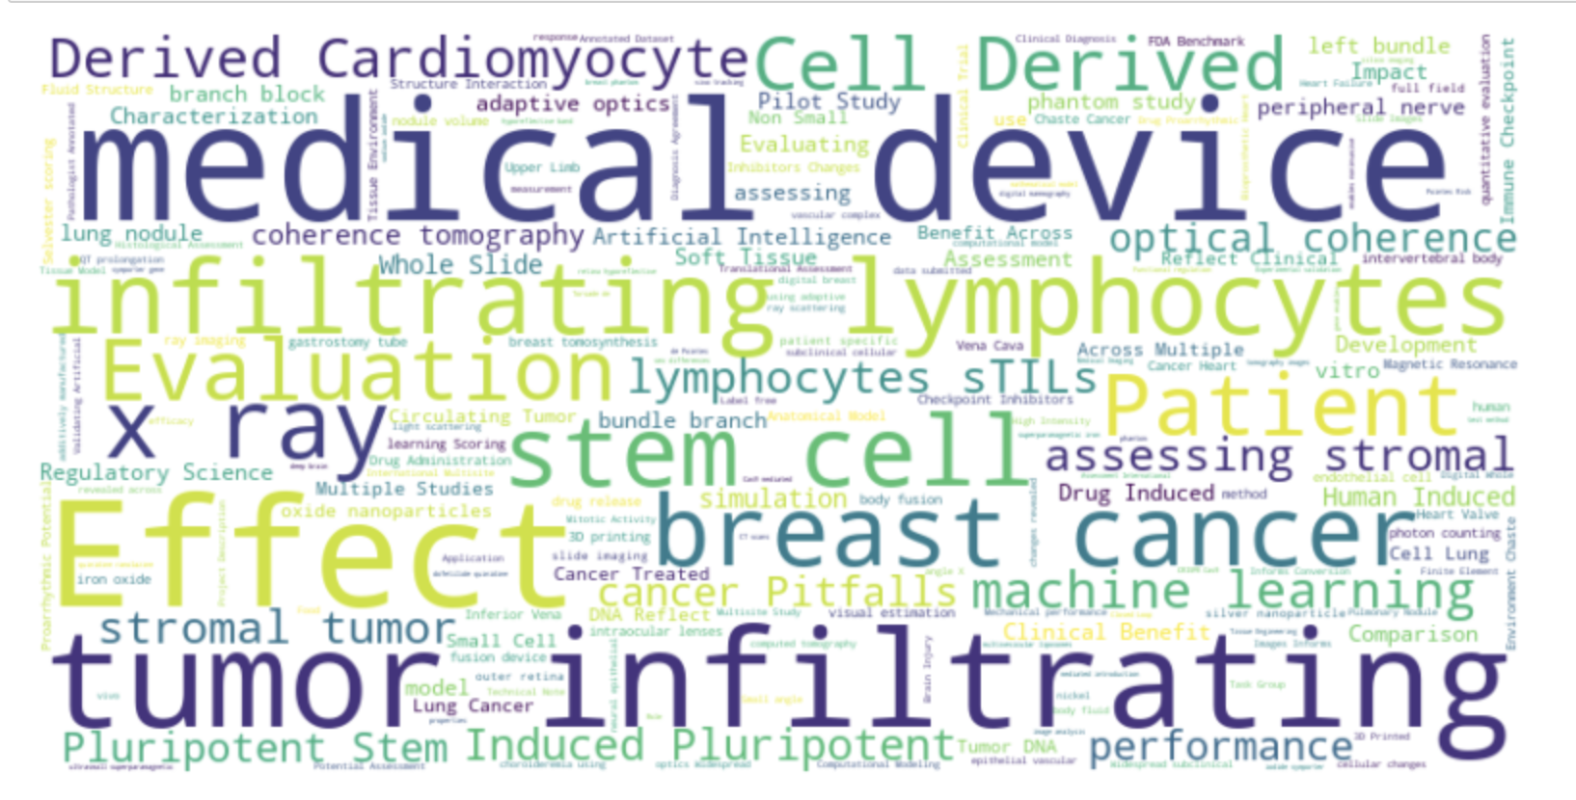
Word Cloud Of Publication Titles

Slide 12
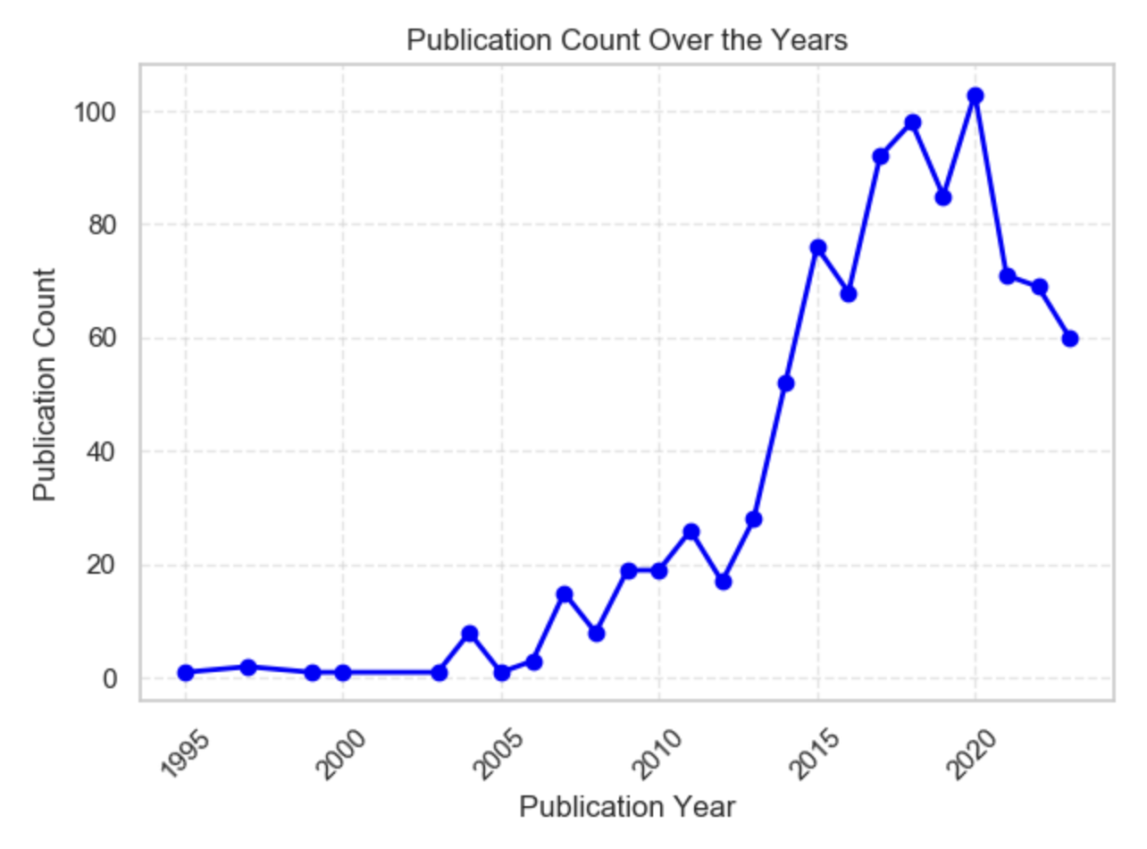
Publication Counts Over Time

Slide 13
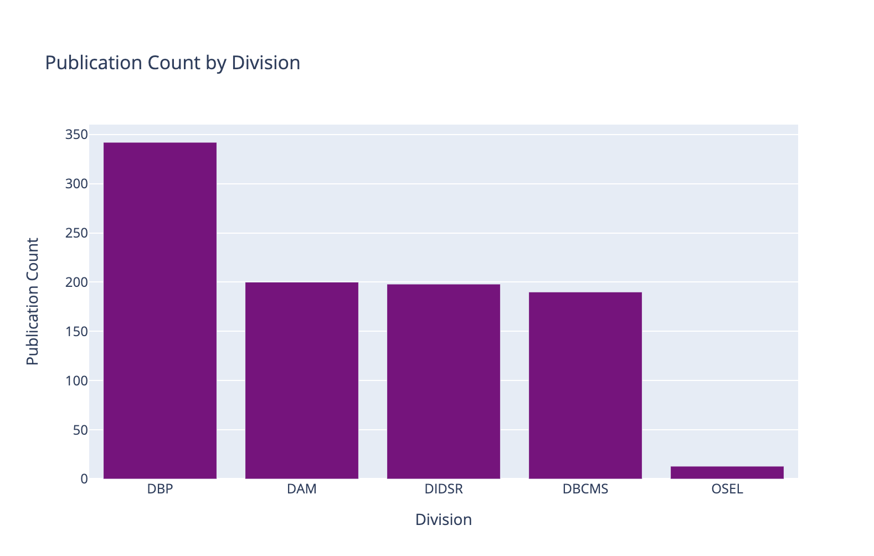
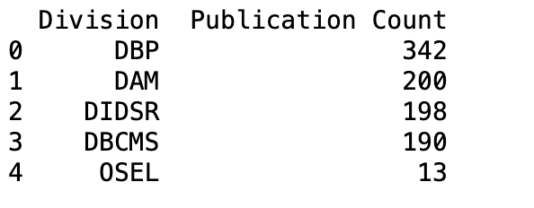
Publication count per division

Slide 14
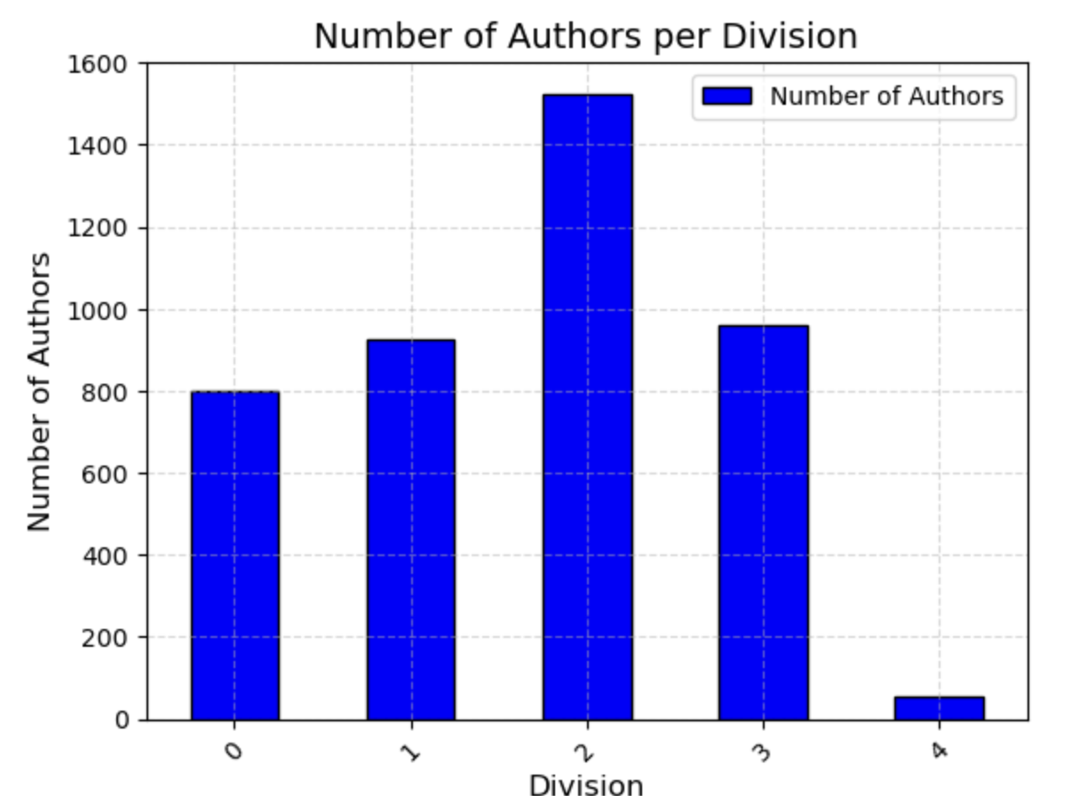
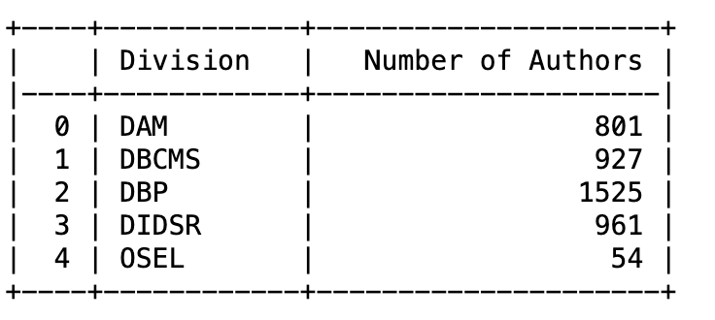
Number Of Authors Per Division
Notes:
DAM goes from 2nd to 4rht

Slide 15
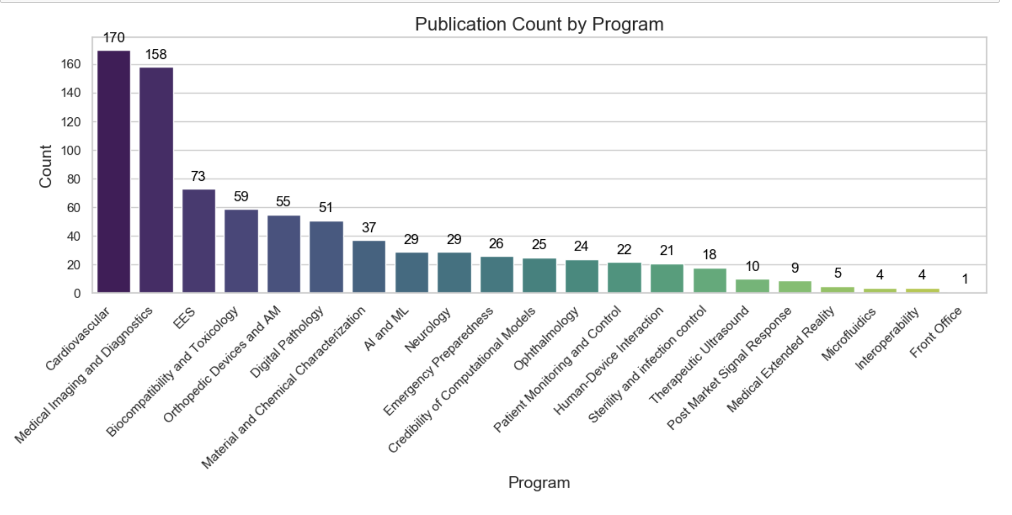
Publication Count Per Program

Slide 16
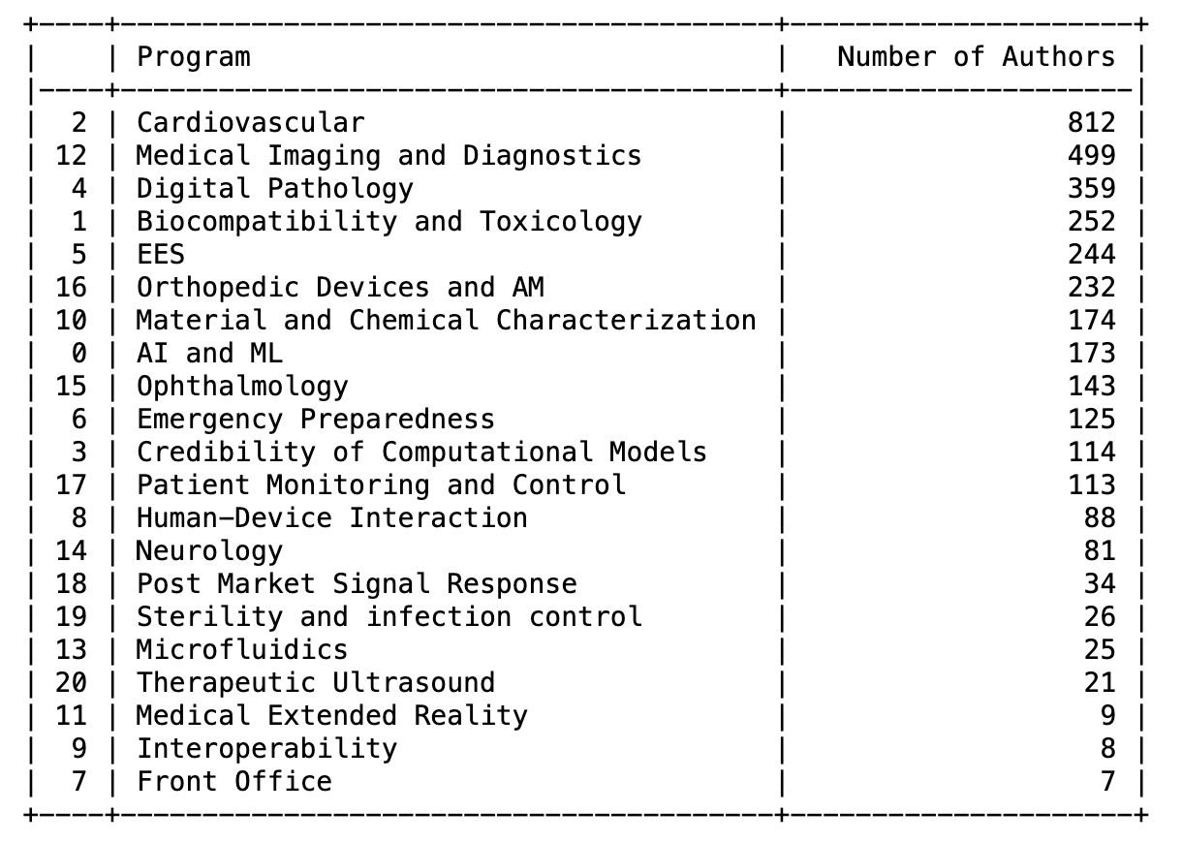
Total Number Of Authors Per Program
Notes:
Conclude the 3 top productive programs in OSEL

Slide 17
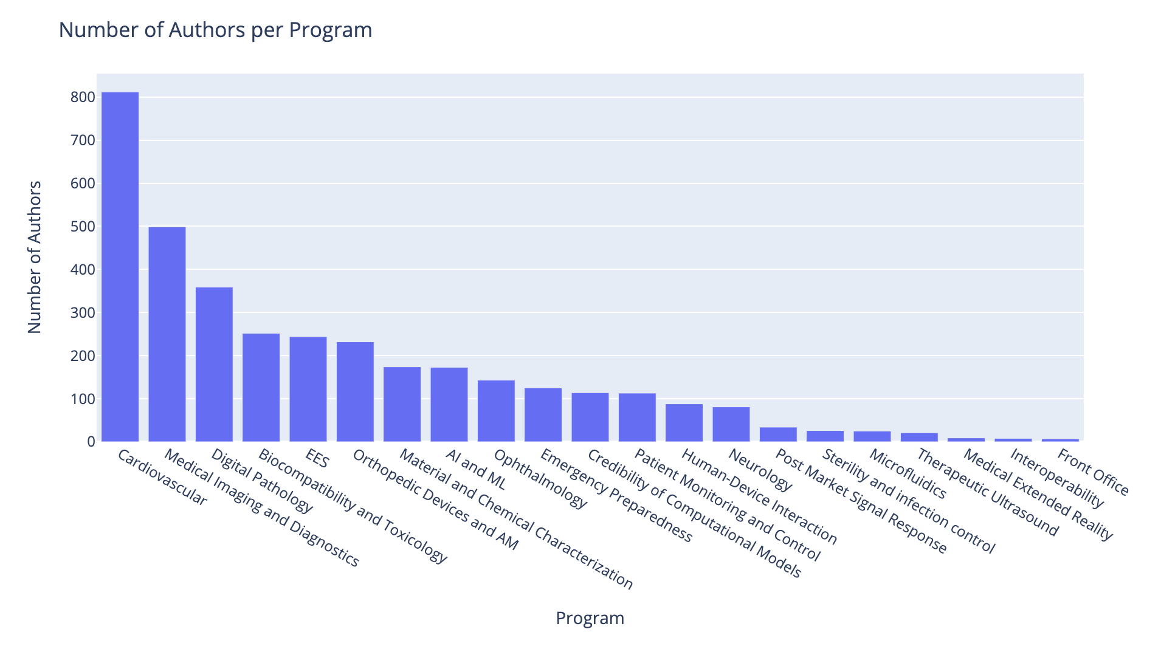
Total Number of Authors Per Program

Slide 18
Measure productivity by assessing collaboration by analyzing the number of authors per publication In both divisions and programs.
Measure productivity by publication counts
Measure collaboration by number of authors per publication

Slide 19
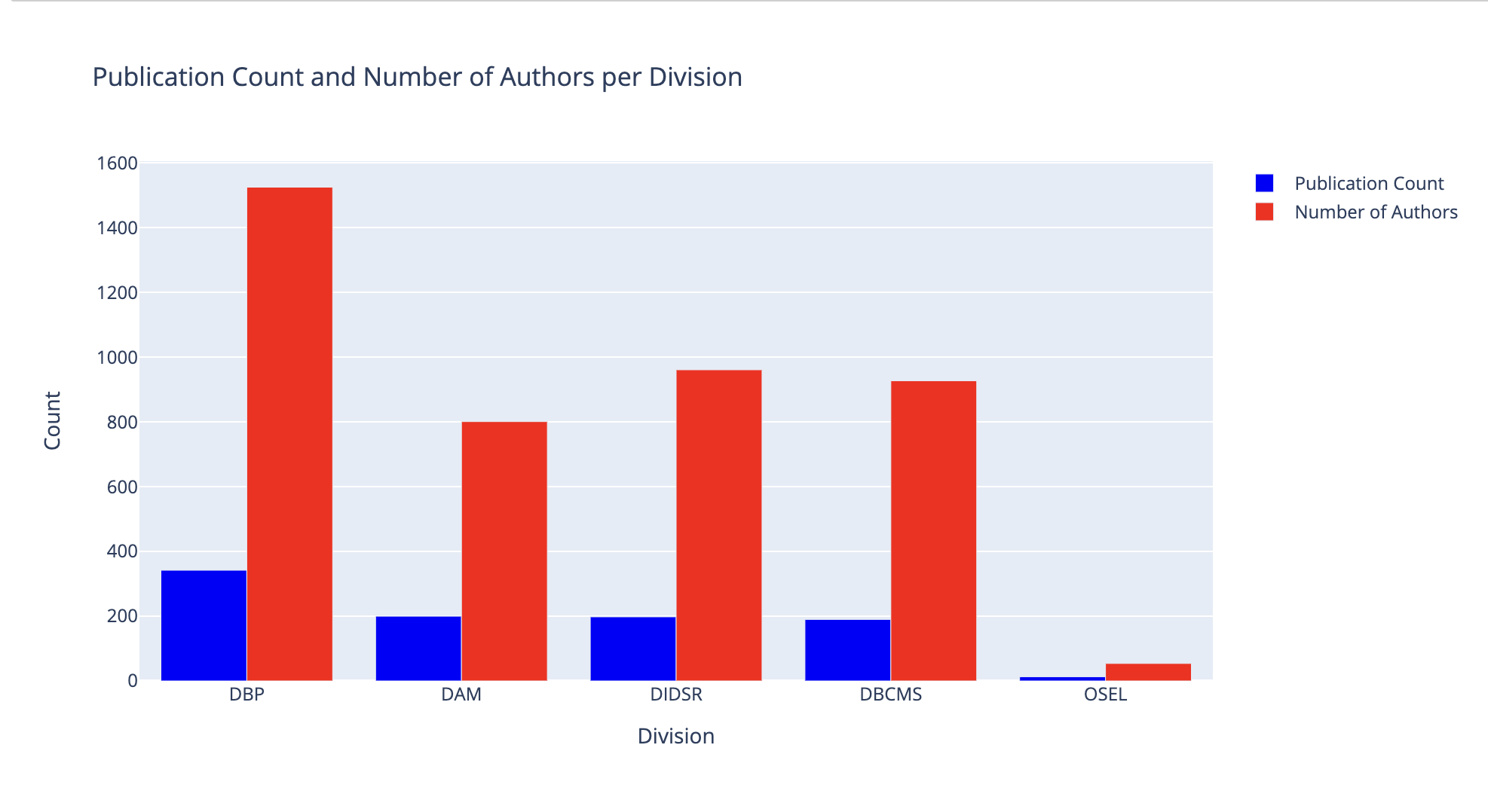
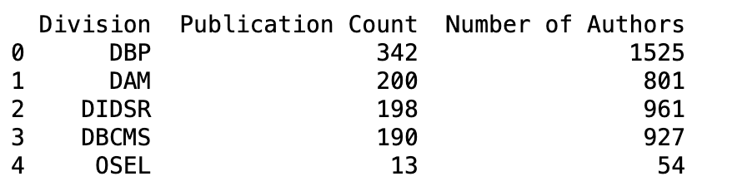
PUBLICATIONS VS NUMBER OF AUTHORS PER DIVISION
Notes:
Are number of authors causing more publications?

Slide 20
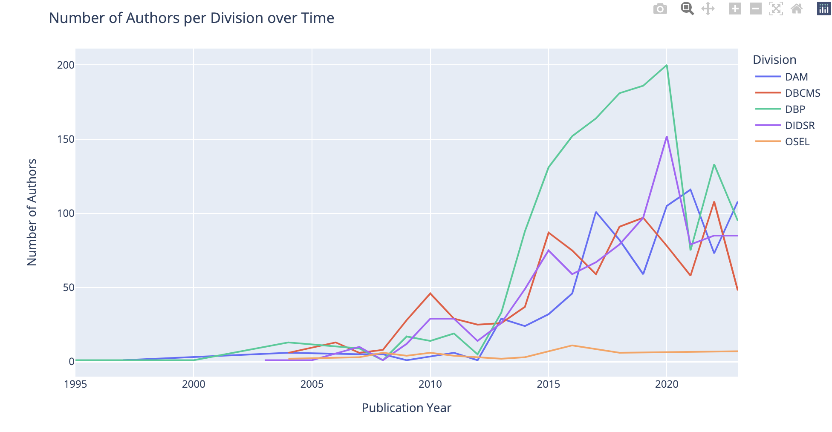
Total Number of Authors Per Division Over Time
Notes:
Its really interesting that where one goes down, the other one rises, so again we can question is this because of collaboration and that authors collaborate between divisions focusing on one at a time? OR competition?

Slide 21
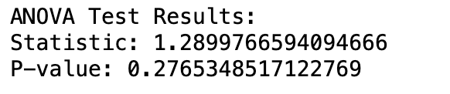
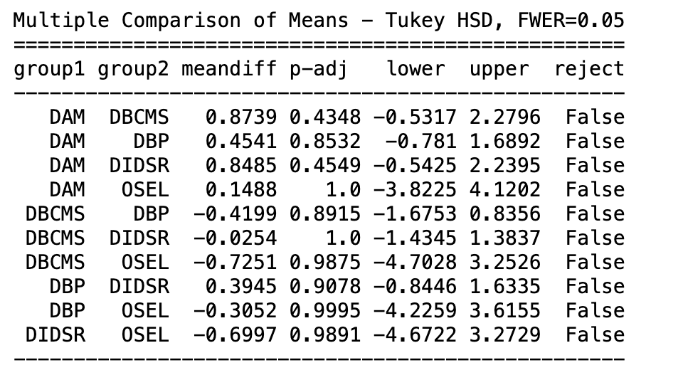
Anova test – significance of average number of authors per publication in each division
Null Hypothesis – There is no significance in the average number of authors per publication in each division
Alternative hypothesis – There is a significance in average number of authors per publication in each division
We fail to reject the null hypothesis and conclude: There is no significant difference in publication counts by looking at the number of authors per publication. It is not that a particular divisions work quality is much better, it is just the mere fact that there are more people working under that division.

Slide 22
Let's look at the productivity of the programs in OSEL

Slide 23
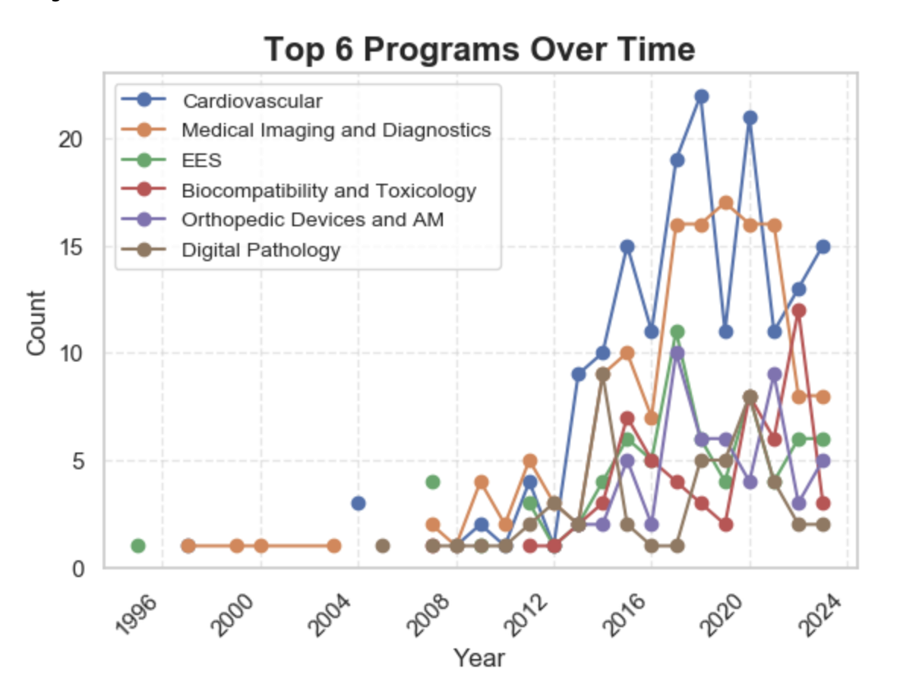
Top 6 Programs Over Time
Notes:
2 reasons – People really didn’t start writing until after about 2005.

Slide 24
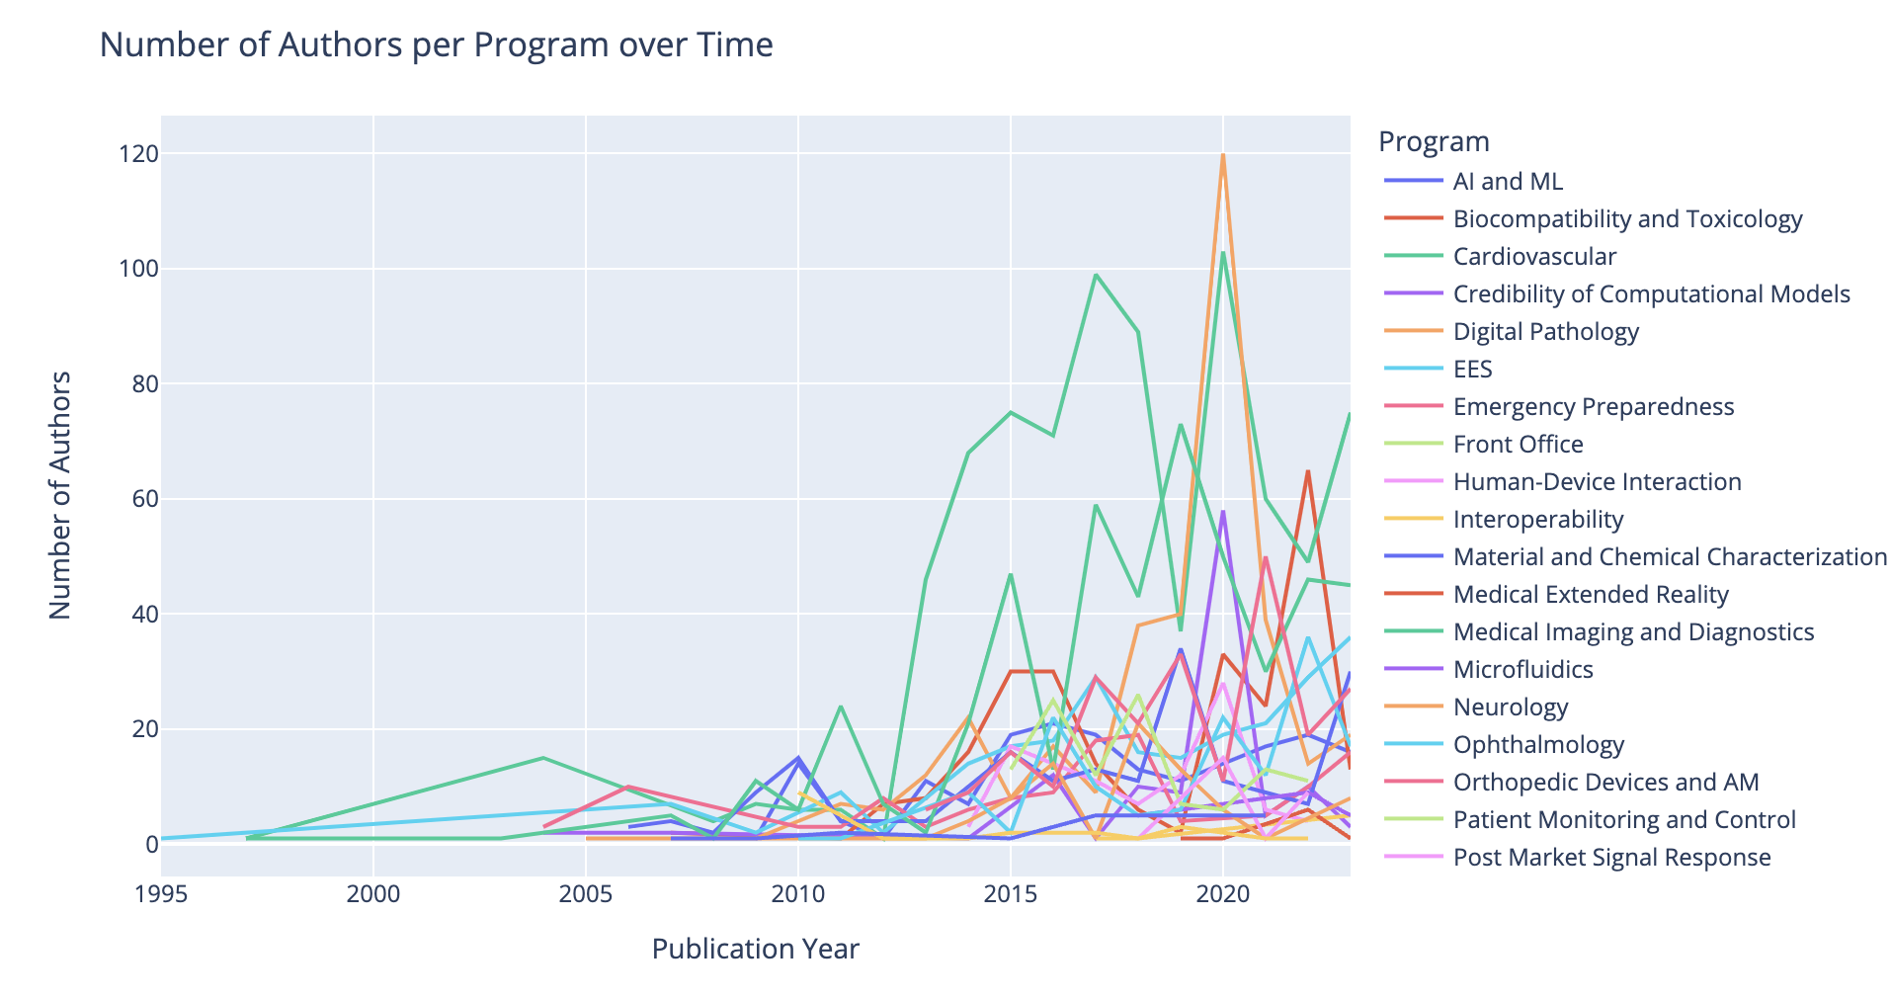
Total Number of Authors per Program Over Time
Notes:
Looking to grow – cardiovascular has a lot of publications already by collaboration, but also looking to grow in number of authors in general

Slide 25
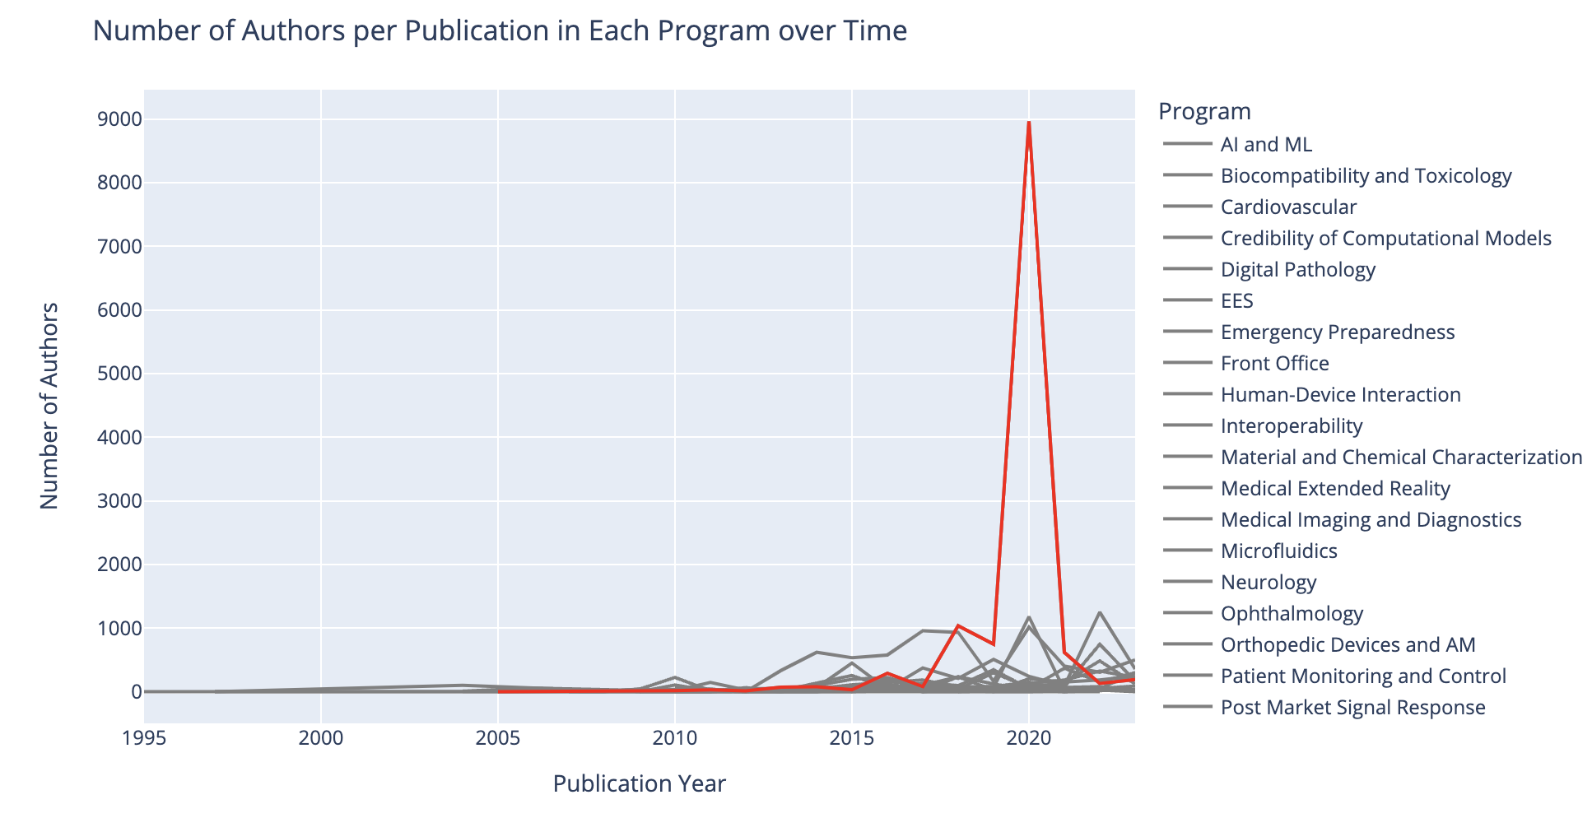
Number of Authors Per Program Over Time – Digital Pathology Strike

Slide 26
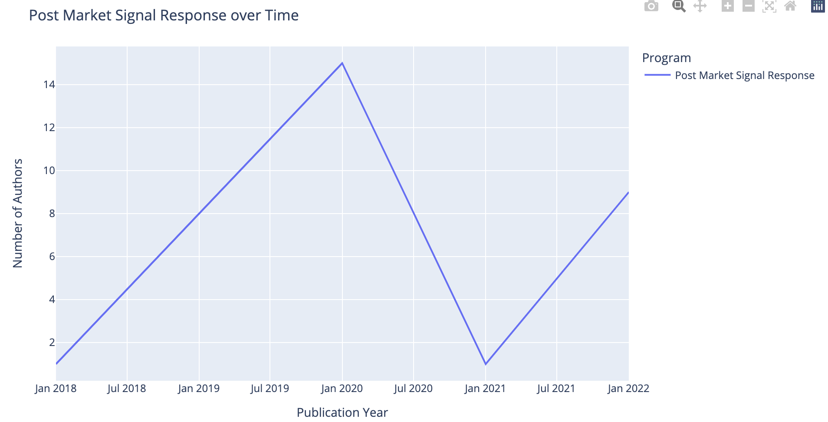
Post Market Signal Response

Slide 27
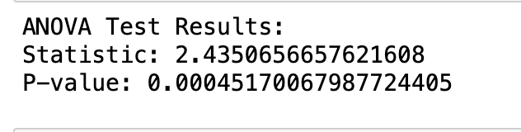
Anova Test: significance of average number of authors per publication in each Program
Null Hypothesis: There is no significance difference between the average number of authors in each program
Alternative Hypothesis: There is a significant difference between the average number of authors per program
We reject the null hypothesis and conclude: There is a significant difference in publication counts by looking at the average number of authors per publication. This indicates that collaboration under each program does in fact affect the productivity of that program. Thus, we can conclude which programs are most successful.
Notes:
Now that we know that number of authors makes a difference, lets see who the authors are, and which ones are the most successful in this office

Slide 28
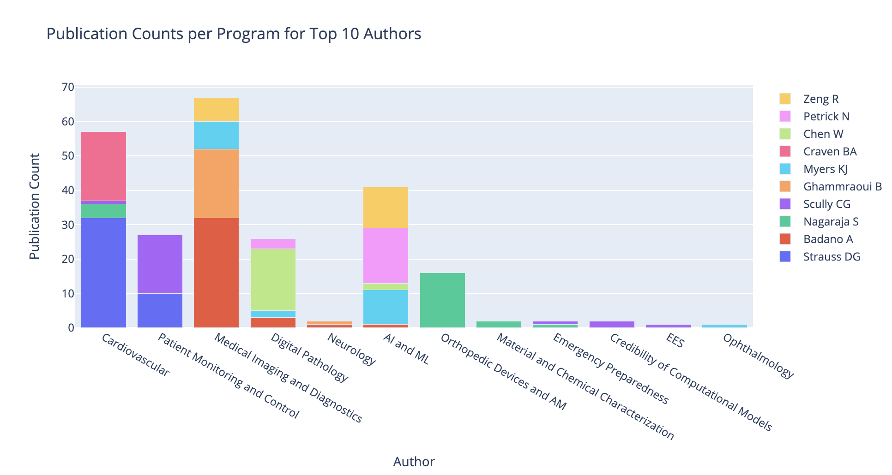
Confirms Collaboration Which Could Be a Factor For More Publications
Fun Fact:
Although one program can be involved in more than one division, its notable that DBP is involved in so many programs.
Cardiovascular – DAM
Patient Monitoring and Control – DBP
Medical Imaging and Diagnostics – DBP
Digital Pathology – DBP
AI and ML - DBP
Notes:
By looking at the top 10 authors, we can see which program is infact more productive under OSEL. Also which authors are more colloborative.

Slide 29
CONCLUSION – Data Product
Interestingly, collaboration did not seem to be a measure of success in the divisions, but it showed a significant impact on productivity for each program. This suggests that collaboration plays a crucial role in program productivity.
In terms of program productivity, the DBP division emerged as the most productive division.
Additionally, the top three most collaborative authors across programs were Phillips KS, Nagaraja S, and Scully CG. These authors collaborated with multiple programs, showcasing their expertise and involvement in various areas.
The three most productive programs under the OSEL division were Cardiovascular, Medical Imaging and Diagnostics, and AI and ML. These programs demonstrated high levels of productivity within the OSEL division.
Lastly, we can conclude that productivity decreased across all programs, authors, and divisions during the pandemic. However, programs started to publish again, while the productivity in the Divisions of OSEL remained consistent.

Slide 30

Thank you!
Dr Jenna Osborn – for invaluable mentorship
Nicole Leung – for all your dedication and time
Lope and Matt – for all the support and encouragement
Professor Michael Lapalucci – for all your guidance and commitment
My wonderful class

